Slide 1
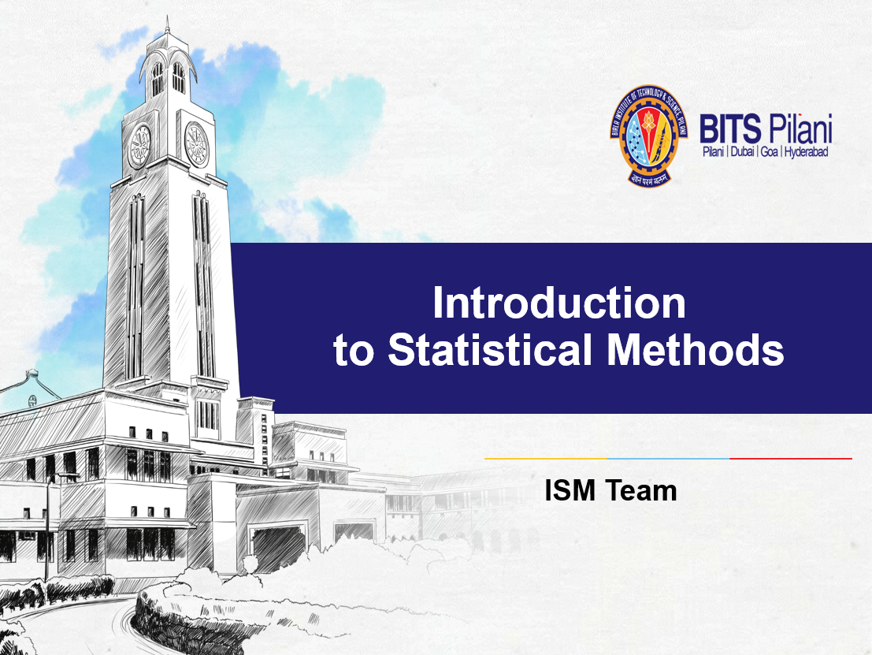

Slide 2
Session 12
Time Series/ Forecasting
(Session 12: 22th / 23th February 2025)

Slide 3

IMP Note to Self

Slide 4
Time Series

Slide 5
Statistical Methods for Data Science
Time Series
Definition
A time series is defined as a set of observations on a variable generated sequentially in time. The measurement of the variable may be made continuously or at discrete (equally spaced) intervals.
Often a variable continuous in time is measured at regular intervals and this produces a discrete series of data.

Slide 6
Statistical Methods for Data Science
Time Series
Definition
Time series may be represented as a set of data (Y₁, Y₂, Y₃, …, Y_{n}), Y_{t} denoting the value of the variable Y at time t.
Example of continuous variable:
-Temperature on a chemical reactor
- Level of tide at a particular site
- Amplitude of an electrical signal

Slide 7
Statistical Methods for Data Science
Time Series
Definition
A discrete time series data may be generated from the accumulation of data over a period of time.
Example of discrete variable:
- Monthly sales
- Daily rainfall
- Production of a crop over different years in a country

Slide 8
Statistical Methods for Data Science
Time Series
Graphs

Slide 9
Statistical Methods for Data Science
Time Series
Graphs

Slide 10
Statistical Methods for Data Science
Time Series
Graphs

Slide 11
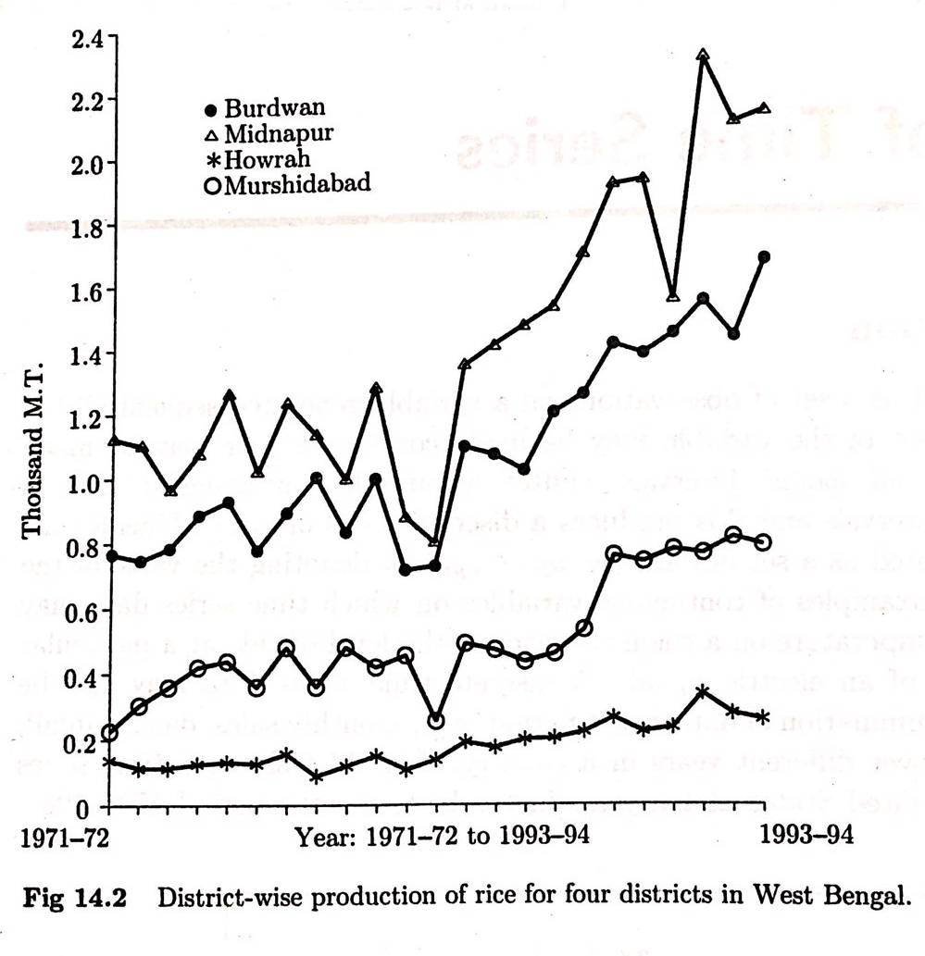
Statistical Methods for Data Science
Time Series
Graphs

Slide 12
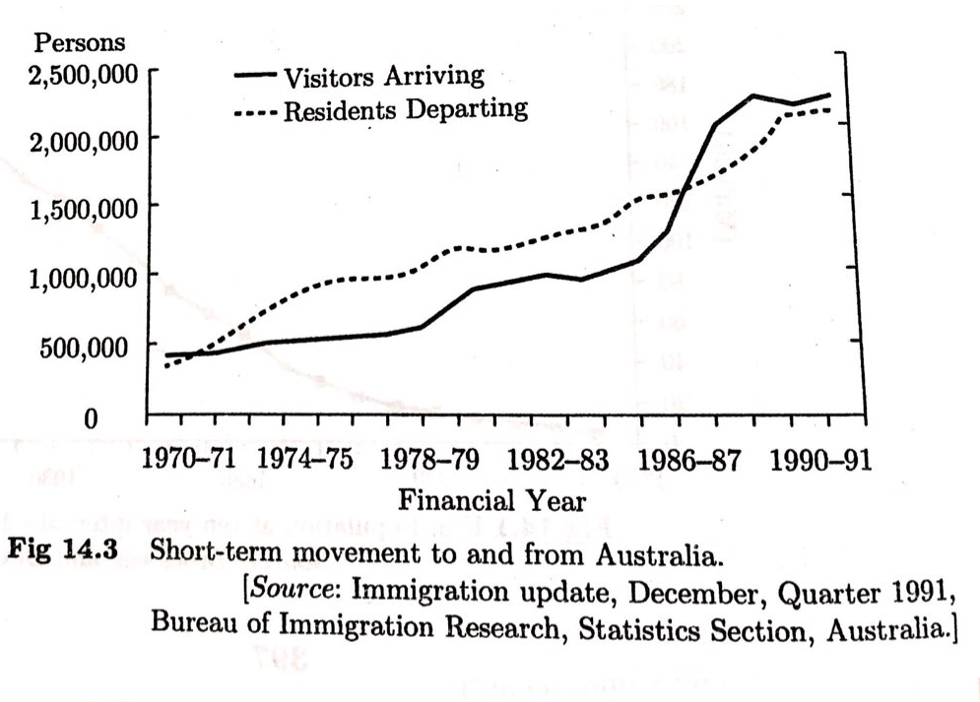
Statistical Methods for Data Science
Time Series
Graphs

Slide 13
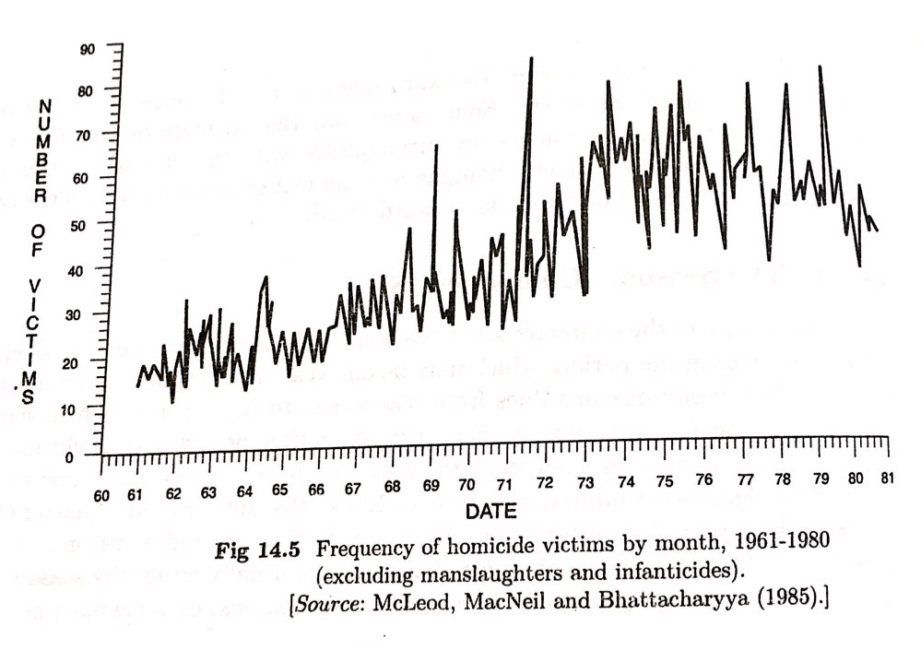
Statistical Methods for Data Science
Time Series
Graphs

Slide 14
Statistical Methods for Data Science
Time Series
Time series models
Time Series Models:
A time series is a set of observations Y_{t} , each one being recorded at a specific time t. A discrete-time time series is one in which the set T₀ of times at which observations are made is a discrete set, as is the case, for example, when observations are made at fixed time intervals.
Continuous - time time series are obtained when observations are recorded continuously over some time interval, e.g., when T₀ [0, 1].

Slide 15
Statistical Methods for Data Science
Time Series
Decomposition Models
This is an important technique for all types of time series analysis, especially for seasonal adjustment. It seeks to construct, from an observed time series, a number of component series (that could be used to reconstruct the original by additions or multiplications) where each of these has a certain characteristic or type of behaviour. For example, time series are usually decomposed into:

Slide 16
Statistical Methods for Data Science
Time Series
Decomposition of Time Series as Components
Trend
Seasonal
Cyclical
Irregular

Slide 17
Statistical Methods for Data Science
Time Series
Decomposition view
Assess the trend component by smoothing or curve fitting (regression with time)
Assess/ account for seasonality i.e. de-seasonalize the data
Additive Adjustment: Look at all periods of a given type (eg. First Qtr periods where data is quarterly, or a all August period where the data is monthly) & compute an average deviation of the actual values from the smooth or fitted values in those periods. The average can then be added to the trend to adjust for seasonality.
Multiplicative adjustment: Instead of calculating the average deviation, compute an average ratio, also called seasonal indices, of the actual values to the smooth or fitted values in those periods. The indices are then used as multiplier to adjust for seasonality.
Forecast by projecting trend component into the future and then adding or multiplying the seasonal component, as the case may be according to your chosen model

Slide 18
Statistical Methods for Data Science
Time Series
Decomposition Models
T_{t}: the trend component at time t, which reflects the long-term progression of the series (secular variation). A trend exists when there is a persistent increasing or decreasing direction in the data. The trend component does not have to be linear

Slide 19
Statistical Methods for Data Science
Time Series
Time Series Components
Trend:
Response
Persistent, overall upward or downward pattern
Due to population, technology etc.
Several years duration
Upward trend
Mo., Qtr., Yr.

Slide 20
Statistical Methods for Data Science
Time Series
Seasonal variation
S_{t}: the seasonal component at time t, reflecting seasonality (seasonal variation). A seasonal pattern exists when a time series is influenced by seasonal factors. Seasonality occurs over a fixed and known period (e.g., the quarter of the year, the month, or day of the week)

Slide 21
Statistical Methods for Data Science
Time Series
Time Series Components
Regular pattern of up & down fluctuations
Due to weather, customs etc.
Occurs within one year
Response
Summer
© 1984-1994 T/Maker Co.
Mo., Qtr.

Slide 22
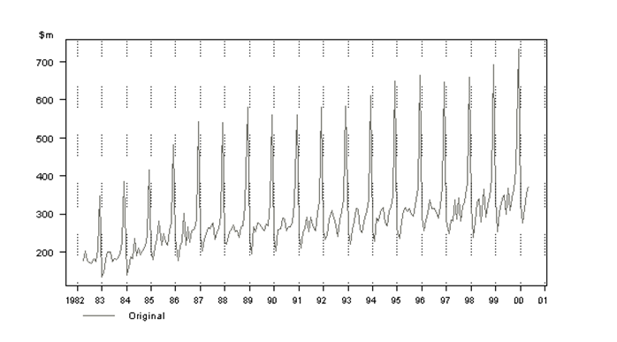
Statistical Methods for Data Science
Time Series
Seasonal variation

Slide 23
Statistical Methods for Data Science
Time Series
Cyclical variation
C_{t}: the cyclical component at time t, which reflects repeated but non-periodic fluctuations. The duration of these fluctuations is usually of at least two years

Slide 24
Statistical Methods for Data Science
Time Series
Cyclical variation
Cyclical variations also have recurring patterns but with a longer and more erratic time scale compared to Seasonal variations.
The name is quite misleading because these cycles can be far from regular and it is usually impossible to predict just how long periods of expansion or contraction will be.
There is no guarantee of a regularly returning pattern.

Slide 25
Statistical Methods for Data Science
Time Series
Time Series Components
Cyclical:
Response
Repeating up & down movements above trend line
Due to interactions of factors influencing economy
Usually 2-10 years duration
Cycle
Mo., Qtr., Yr.

Slide 26
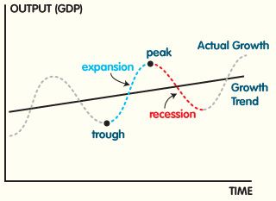
Statistical Methods for Data Science
Time Series
Cyclical variation
This chart represents an economic cycle, but we know it doesn’t always go like this. The timing and length of each phase is not predictable.

Slide 27
Statistical Methods for Data Science
Time Series
Irregular variation
I_{t}: the irregular component (or "noise") at time t, which describes random, irregular influences. It represents the residuals or remainder of the time series after the other components have been removed.

Slide 28
Statistical Methods for Data Science
Time Series
Irregular variation
An irregular (or random) variation in a time series occurs over varying (usually short) periods.
It follows no pattern and is by nature unpredictable.
It usually occurs randomly and may be linked to events that also occur randomly.
Irregular variation cannot be explained mathematically.

Slide 29
Statistical Methods for Data Science
Time Series
Irregular variation
If the variation cannot be accounted for by secular trend, season or cyclical variation, then it is usually attributed to irregular variation. Example include:
Sudden changes in interest rates
Collapse of companies
Natural disasters
Sudden shift s in government policy
Dramatic changes to the stock market
Effect of Middle East unrest on petrol prices.

Slide 30
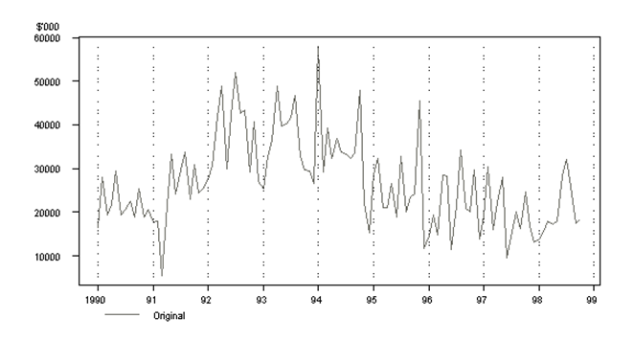
Statistical Methods for Data Science
Time Series
Irregular variation

Slide 31
Statistical Methods for Data Science
Time Series
Decomposition of Time Series Components
Hence a time series using an additive model can be thought of as:
y_{t} = T_{t} + C_{t} + S_{t} + I_{t}
Where as the multiplicative model can be thought of as:
y_{t} = T_{t} x C_{t} x S_{t} x I_{t}

Slide 32
Statistical Methods for Data Science
Time Series
Decomposition Models
Additive model would be used when the variations around the trend do not vary with the level of the time series.
Multiplicative model would be appropriate if the trend is proportional to the level of the time series.

Slide 33
Statistical Methods for Data Science
Time Series
Decomposition of Time Series Components
Sometimes the trend and cyclical components are grouped into one, called the trend-cycle component. The trend-cycle component can just be referred to as the "trend" component, even though it may contain cyclical behaviour. For example, a seasonal decomposition of time series plot decomposes a time series into seasonal, trend and irregular components using loess and plots the components separately, whereby the cyclical component (if present in the data) is included in the "trend" component plot.

Slide 34
Statistical Methods for Data Science
Time Series
Definition of Forecasting
Forecasting is the process of making predictions of the
future based on past and present data and most commonly
by analysis of trends. A commonplace example might be
estimation of some variable of interest at some specified future
date.

Slide 35
Statistical Methods for Data Science
Time Series
Forecasting, Planning and Goals
Forecasting:
is about predicting the future as accurately as possible, given all of the information available, including historical data and knowledge of any future events that might impact the forecasts

Slide 36
Statistical Methods for Data Science
Time Series
Forecasting, Planning and Goals
Planning:
is a response to forecasts and goals. Planning involves determining the appropriate actions that are required to make your forecasts match your goals.

Slide 37
Statistical Methods for Data Science
Time Series
Forecasting, Planning and Goals
Goals:
are what you would like to have happen. Goals should be linked to forecasts and plans, but this does not always occur. Too often, goals are set without any plan for how to achieve them, and no forecasts for whether they are realistic.

Slide 38
Statistical Methods for Data Science
Time Series
Forecasting frame
Short-term Forecasts
Short-term forecasts generally involve some form of scheduling which may include for example the seasons of the year for planning purposes.
The cyclical and seasonal factors are more important in these situations.

Slide 39
Statistical Methods for Data Science
Time Series
Forecasting frame
Short-term Forecasts
Such forecasts are usually prepared every 6 months or on a more frequent basis.
These forecasts are needed for the scheduling of personnel, production and transportation. As part of the scheduling process, forecasts of demand are often also required.

Slide 40
Statistical Methods for Data Science
Time Series
Forecasting frame
Medium-term Forecasts
Medium-term forecasts are generally prepared for planning, scheduling, budgeting and resource requirements purposes.
Medium-term forecasts are needed to determine future resource requirements, in order to purchase raw materials, hire personnel, or buy machinery and equipment.

Slide 41
Statistical Methods for Data Science
Time Series
Forecasting frame
Medium-term Forecasts
The trend factor, as well as the cyclical component, plays a key role in the medium-term forecast as the year to year variations in traffic growth are an important element in the planning process

Slide 42
Statistical Methods for Data Science
Time Series
Forecasting frame
Long-term Forecasts
Long-term forecasts are used mostly in connection with strategic planning to determine the level and direction of capital expenditures and to decide on ways in which goals can be accomplished.
The trend element generally dominates long term situations and must be considered in the determination of any long-run decisions.

Slide 43
Statistical Methods for Data Science
Time Series
Forecasting frame
Long-term Forecasts
The methods generally found to be most appropriate in long-term situations are econometric analysis and life‑cycle analysis. Long-term forecasts are used in strategic planning. Such decisions must take account of market opportunities, environmental factors and internal resources.

Slide 44
Statistical Methods for Data Science
Time Series
Forecasting frame
Long-term Forecasts
It is also important that since the time span of the forecast horizon is long, forecasts should be calibrated and revised at periodic intervals (every two or three years depending on the situation).

Slide 45
Statistical Methods for Data Science
Time Series
The basic steps in a forecasting task
Step 1: Problem definition
Step 2: Gathering information
Step 3: Preliminary (exploratory) analysis
Step 4: Choosing and fitting models
Step 5: Using and evaluating a forecasting model

Slide 46
Statistical Methods for Data Science
Time Series
Types of forecasting methods
Forecasting Methods
Qualitative
Quantitative
Personal Opinion or Judgment
Panel consensus
Delphi Method
Market Research
Time Series
Causal
Smoothing methods
Exponential smoothing
Trend projection method
Regression Trend Analysis

Slide 47
Statistical Methods for Data Science
Time Series
Qualitative forecasting
Personal Opinion
Individuals forecasts future based on their own judgment or opinion without any formal model
Such assessments are relatively reliable and accurate

Slide 48
Statistical Methods for Data Science
Time Series
Qualitative forecasting
Panel consensus
Reduces the prejudice and ignorance that may arise in the individual judgment
Possible to develop consensus among group of individuals
Panel of individuals are encouraged to share information, opinions, and assumptions, if any, to predict future value of some variable under study

Slide 49
Statistical Methods for Data Science
Time Series
Qualitative forecasting
Delphi Method
The Delphi method was invented by Olaf Helmer and Norman Dalkey of the Rand Corporation in the 1950s for the purpose of addressing a specific military problem. The method relies on the key assumption that forecasts from a group are generally more accurate than those from individuals.

Slide 50
Statistical Methods for Data Science
Time Series
Qualitative forecasting
Delphi Method
The aim of the Delphi method is to construct consensus forecasts from a group of experts in a structured iterative manner. A facilitator is appointed in order to implement and manage the process. The Delphi method generally involves the following stages:

Slide 51
Statistical Methods for Data Science
Time Series
Qualitative forecasting
Delphi Method
A panel of experts is assembled.
Forecasting tasks/challenges are set and distributed to the experts.
Experts return initial forecasts and justifications. These are compiled and summarised in order to provide feedback.

Slide 52
Statistical Methods for Data Science
Time Series
Qualitative forecasting
Delphi Method
Feedback is provided to the experts, who now review their forecasts in light of the feedback. This step may be iterated until a satisfactory level of consensus is reached.
Final forecasts are constructed by aggregating the experts’ forecasts.

Slide 53
Statistical Methods for Data Science
Time Series
Qualitative forecasting
Delphi Method
Each stage of the Delphi method comes with its own challenges. In what follows, we provide some suggestions and discussions about each one of these.

Slide 54
Statistical Methods for Data Science
Time Series
Qualitative forecasting
Market Research Method
This method is used to collect based on well-defined objectives and assumptions about future value of variable.
Questionnaire is used to gather data and prepared summary of responses.
This method produces a narrow range of forecasts rather than a single view of future.

Slide 55
Statistical Methods for Data Science
Time Series
Qualitative forecasting

Slide 56
Statistical Methods for Data Science
Time Series
Stochastic Process

Slide 57
Statistical Methods for Data Science
Time Series
Modelling Time Series
Modeling Time Series
Methods for forecasting a time series fall into two general classes: smoothing methods and regression-based modeling methods.
Although the smoothing methods do not explicitly use the time series components, it is a good idea to keep them in mind. The regression models explicitly estimate the components as a basis for building models.

Slide 58
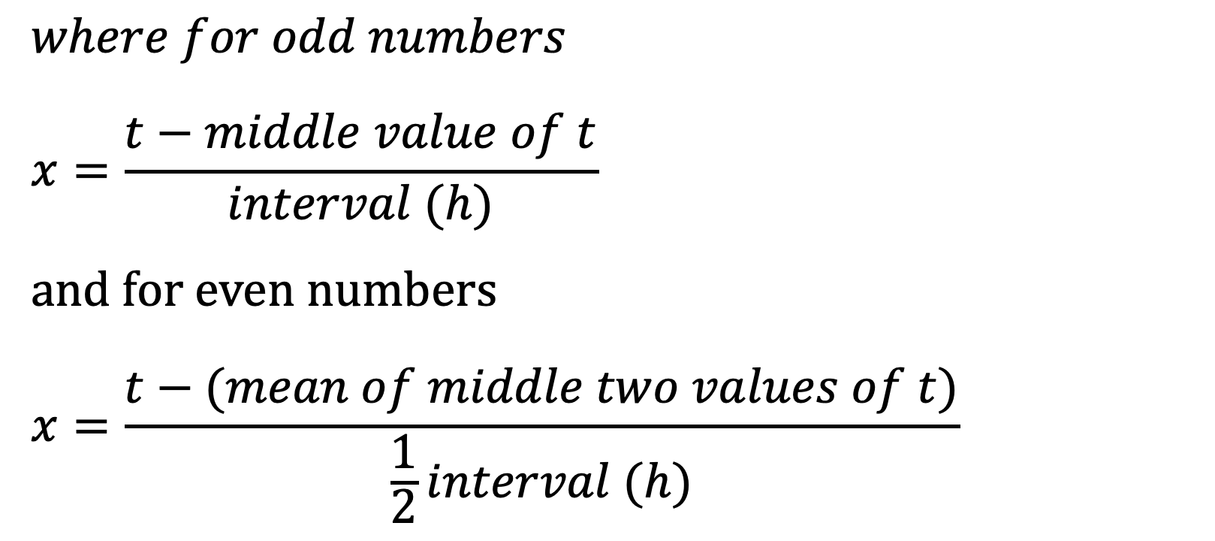
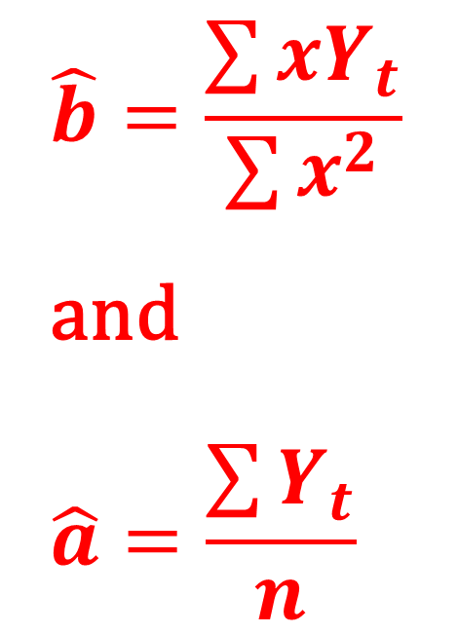
Statistical Methods for Data Science
Time Series
Fitting a trend to Time Series
A linear trend between time series values Y_{t} and the time t is given by the equation Y_{t} = a + bt +e.
For the pair of values of (Y_{t}, t), a & b as estimated by the principles of least squares are
$$where for odd numbers$$
$$x=\frac{t−middle value of t}{interval (h)}$$
and for even numbers
$$x=\frac{t−(mean of middle two values of t)}{\frac{1}{2}interval (h)}$$
$$\hat{b}=\frac{\sum{{xY}_{t}}}{\sum{x^{2}}}$$
and
$$\hat{a}=\frac{\sum{Y_{t}}}{n}$$

Slide 59
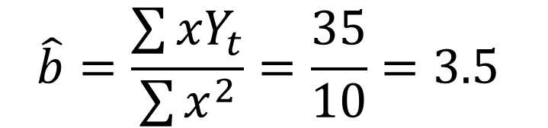
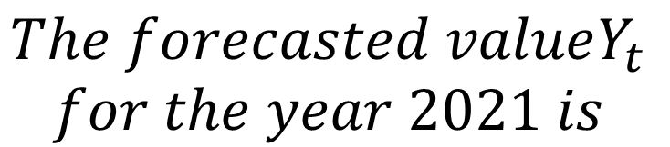
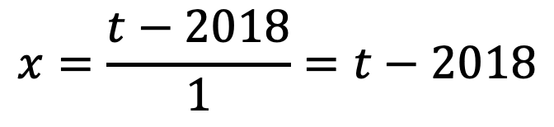

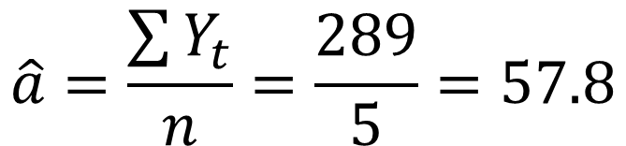
Statistical Methods for Data Science
Time Series
Fitting a trend to Time Series
The following data relates to production of crops (in tons) in a place from 2016 -2020. Fit a linear trend Y_{t} = a + bt +e for the data given below:
 | Year (t) | Production (tons) (Y_{t})
 | 2016 | 35
 | 2017 | 55
 | 2018 | 79
 | 2019 | 80
 | 2020 | 40
Sum | 10090 | 289
x = t-2018
-2
-1
0
1
2
0
x²
4
1
0
1
4
10
xY_{t}
-70
-55
0
80
80
35
$$\hat{b}=\frac{\sum{{xY}_{t}}}{\sum{x^{2}}}=\frac{35}{10}=3.5$$
$$\hat{a}=\frac{\sum{Y_{t}}}{n}=\frac{289}{5}=57.8$$
$$\hat{Y_{t}}=\hat{a}+ \hat{b} x=57.8+3.5x$$
$$The forecasted valueY_{t}$$
$$for the year 2021 is$$
$$x=\frac{t−2018}{1}=t−2018$$
$$\hat{Y_{t}}=\hat{a}+ \hat{b} x=57.8+3.5 \left(3\right)=68.3$$

Slide 60
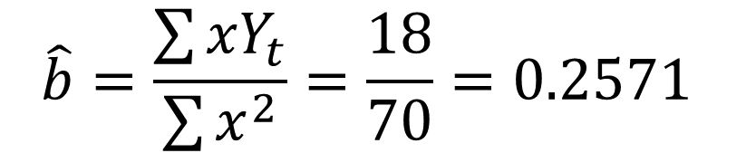
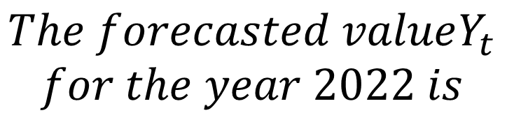
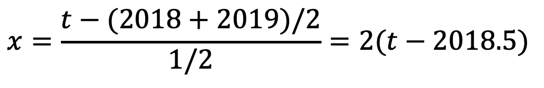
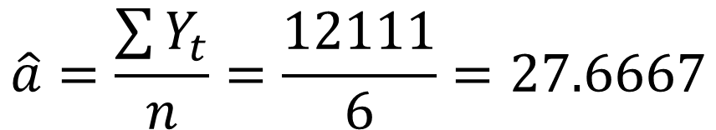
Statistical Methods for Data Science
Time Series
Fitting a trend to Time Series
The following data relates to Sale (in ‘000) in a Mall from 2016 -2021. Fit a linear trend Y_{t} = a + bt +e for the data given below:
 | Year (X) | Sales (‘000) (Y_{t})
 | 2016 | 23
 | 2017 | 27
 | 2018 | 31
 | 2019 | 34
 | 2020 | 22
 | 2021 | 29
Sum | 12111 | 166
x=X-X
-5
-3
-1
1
3
5
0
x²
25
9
1
1
9
25
70
xY_{t}
-115
-81
-31
34
66
145
18
$$\hat{b}=\frac{\sum{{xY}_{t}}}{\sum{x^{2}}}=\frac{18}{70}=0.2571$$
$$\hat{a}=\frac{\sum{Y_{t}}}{n}=\frac{12111}{6}=27.6667$$
$$\hat{Y_{t}}=\hat{a}+ \hat{b} x=27.6667+0.2571x$$
$$The forecasted valueY_{t}$$
$$for the year 2022 is$$
$$x=\frac{t−(2018+2019)/2}{1/2}=2(t−2018.5)$$
$$\hat{Y_{t}}=\hat{a}+ \hat{b} x=27.6667+0.2571 \left(7\right)=29.4664$$

Slide 61
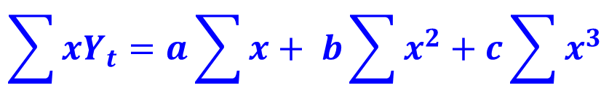
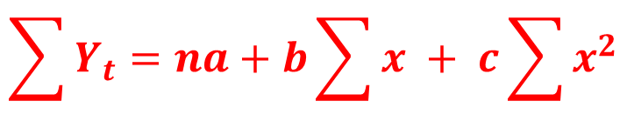
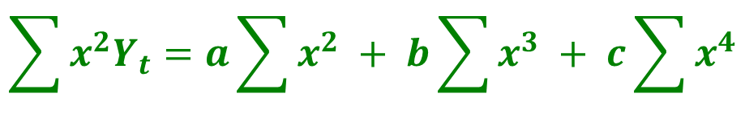
Statistical Methods for Data Science
Time Series
Fitting a trend to Time Series
A trend need not be a linear, it may even be quadratic. Let the quadratic trend between time series values Y_{t} and the time t is given by the equation
Y_{t} = a + bt + ct² + e.
For the pair of values of (Y_{t}, t), a, b and c as estimated by the principles of least squares is given by the system of three normal equations as follows:
$$\sum{Y_{t}}=na+b\sum{x + c\sum{x^{2}}}$$
As there are three equations in three unknown quantities, any of the numerical techniques for solving the system of equations can be made use like Gauss – Elimination method.
$$\sum{xY_{t}}=a\sum{x}+ b\sum{x^{2}+c\sum{x^{3}}}$$
$$\sum{x^{2}Y_{t}}=a\sum{x^{2}} + b\sum{x^{3} + c\sum{x^{4}}}$$
Note: x is defined as in case of fitting linear trend

Slide 62
Statistical Methods for Data Science
Time Series
Simple Moving Average
The idea behind the moving averages is that observations which are nearby in time are also likely to be close in value.
The average of the points near an observation will provide a reasonable estimate of the trend-cycle at that observation.
The average eliminate some of the randomness in the data, and leaves a smooth trend-cycle component.

Slide 63
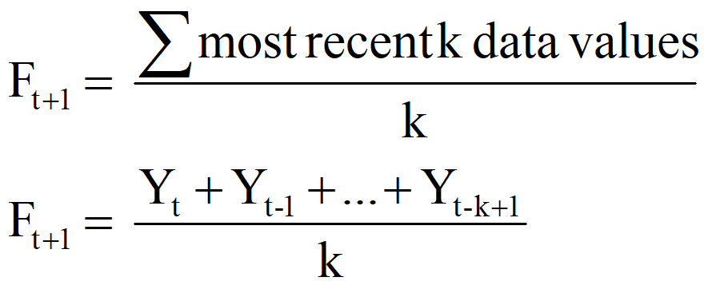
Statistical Methods for Data Science
Time Series
Simple Moving Average
Appropriate for a time series with a horizontal pattern ie., the data that are stationary.
Moving Average (the average of the most recent k data values forms the forecast for the next period)

Slide 64
Statistical Methods for Data Science
Time Series
Centered – Moving Averages
Following data shows production volume (in ‘000 tones). Compute 3-year moving average for all available years
Year | Production
1995 | 21
1996 | 22
1997 | 23
1998 | 25
1999 | 24
2000 | 22
2001 | 25
2002 | 26
2003 | 27
2004 | 26
3-yr MA
22.00
23.33
24.00
23.67
23.67
24.33
26.00
26.33

Slide 65
Statistical Methods for Data Science
Time Series
Forecast by Moving Averages
Following data shows production volume (in ‘000 tones). Compute 3-year moving average for all available years. Forecast production for the year 2005
Year | Production
1995 | 21
1996 | 22
1997 | 23
1998 | 25
1999 | 24
2000 | 22
2001 | 25
2002 | 26
2003 | 27
2004 | 26
3-yr MA
22.00
23.33
24.00
23.67
23.67
24.33
26.00
The forecasted value for the year 2005 based on the last 3-year moving average is 26.33

Slide 66
Statistical Methods for Data Science
Time Series
Centered – Moving Averages for even period
Following data shows production volume (in ‘000 tones). Compute 4-year centered moving average
Year | Production(Y)
1995 | 21.0
1996 | 22.0
1997 | 23.0
1998 | 25.0
1999 | 24.0
2000 | 22.0
2001 | 25.0
2002 | 26.0
2003 | 27.0
2004 | 26.0
2005 | 28.0
4-yearly moving average
22.75
23.50
23.50
24.00
24.25
25.00
26.00
26.75
4-year centered moving average
23.13
23.50
23.75
24.13
24.63
25.50
26.38
26.75

Slide 67
Statistical Methods for Data Science
Time Series
Simple Moving Average
Following data shows production volume (in ‘000 tones). Compute 3 and 5-year moving average
Period (t) | Sales (Y_{t})
1 | 5.3
2 | 4.4
3 | 5.4
4 | 5.8
5 | 5.6
6 | 4.8
7 | 5.6
8 | 5.6
9 | 5.4
10 | 6.5
11 | 5.1
12 | 5.8
13 | 5
14 | 6.2
15 | 5.6
16 | 6.7
17 | 5.2
18 | 5.5
19 | 5.8
20 | 5.1
21 | 5.8
22 | 6.7
23 | 5.2
24 | 6
25 | 5.8
3yr MA sum
5.03
5.20
5.60
5.40
5.33
5.33
5.53
5.83
5.67
5.80
5.30
5.67
5.60
6.17
5.83
5.80
5.50
5.47
5.57
5.87
5.90
5.97
5.67
MA sum
5.30
5.20
5.44
5.48
5.40
5.58
5.64
5.68
5.56
5.72
5.54
5.86
5.74
5.84
5.76
5.66
5.48
5.78
5.72
5.76
5.90

Slide 68
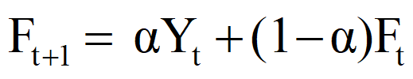
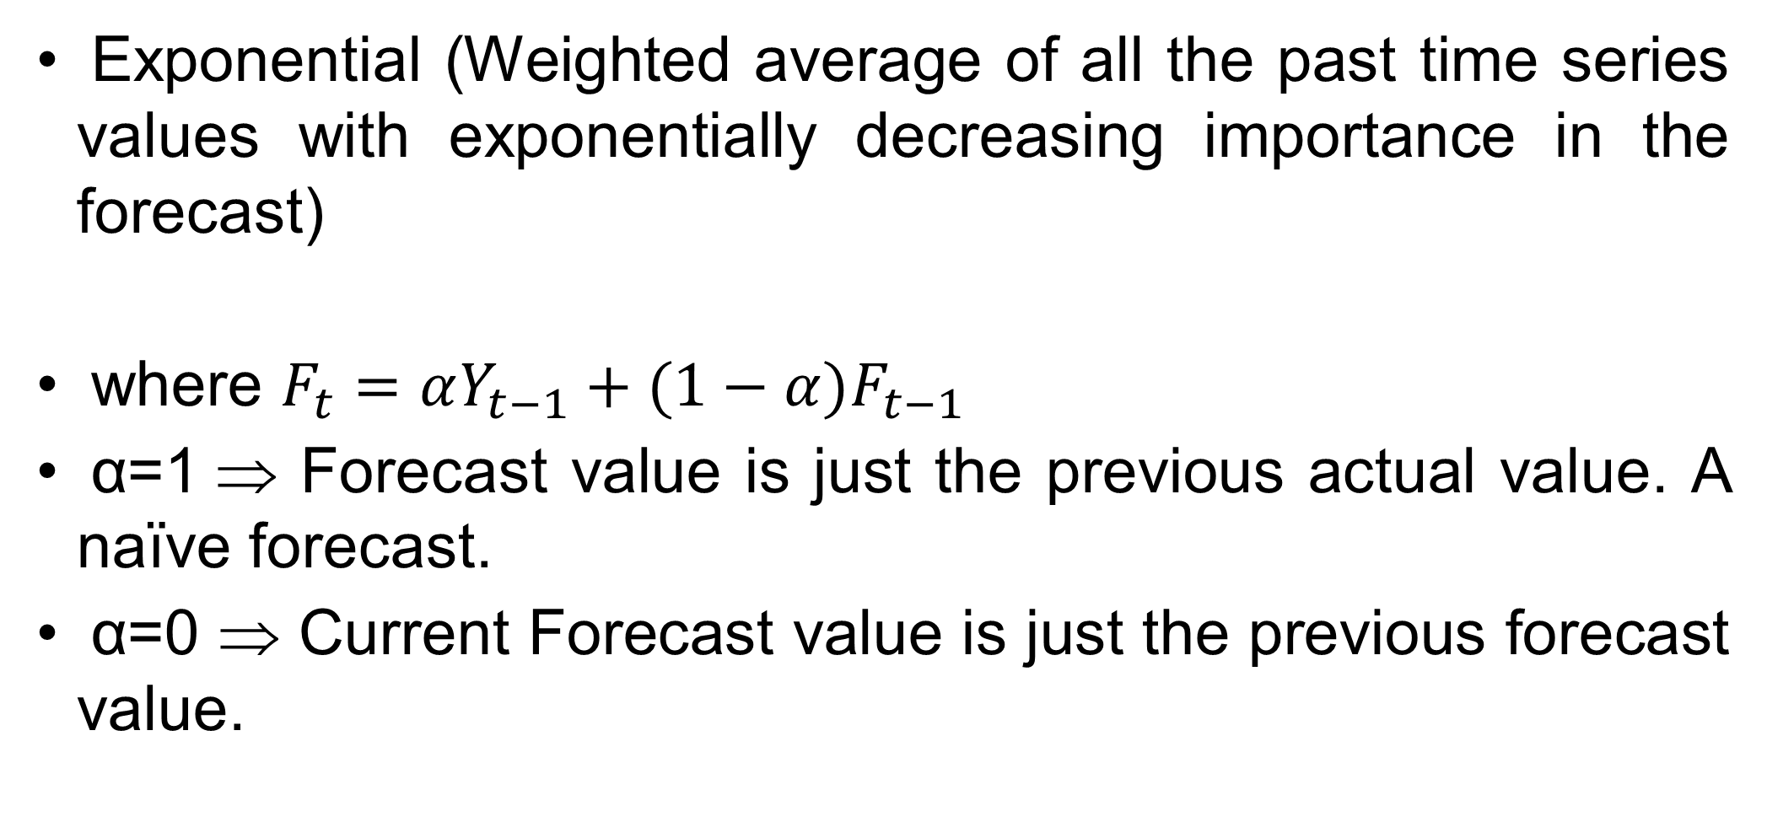
Statistical Methods for Data Science
Time Series
Smoothing Techniques – Exponential
Exponential (Weighted average of all the past time series values with exponentially decreasing importance in the forecast)
where $F_{t}=αY_{t−1}+(1−α)F_{t−1}$
α=1 ⇒ Forecast value is just the previous actual value. A naïve forecast.
α=0 ⇒ Current Forecast value is just the previous forecast value.

Slide 69
Statistical Methods for Data Science
Time Series
Simple Exponential Smoothing
Following data shows production volume (in ‘000 tones). Compute simple exponential smoothing with 𝛂 = 0.3
Year | Production
1995 | 21
1996 | 22
1997 | 23
1998 | 25
1999 | 24
2000 | 22
2001 | 25
2002 | 26
2003 | 27
2004 | 26
2005 | -
Production
21
21
21.3
21.81
22.767
23.1369
22.79583
23.457081
24.2199567
25.05396969
25.33777878
F_{t+1} = α Y_{t} + (1 – α)F_{t}

Slide 70
Quar/Yr | Utilization(%)
Q1/2017 | 82.50
Q2/2017 | 81.30
Q3/2017 | 81.30
Q4/2017 | 79.00
Q1/2018 | 76.60
Q2/2018 | 78.00
Q3/2018 | 78.40
Q4/2018 | 78.00
Q1/2019 | 78.80
Q2/2019 | 78.70
Q3/2019 | 78.40
Q4/2019 | 80.00
Q1/2020 | 80.70
Q2/2020 | 80.70
Q3/2020 | 80.80
Q4/2020
F_{t} (α=0.2)
82.5
82.5
82.26
82.068
81.4544
80.48352
79.98682
79.66945
79.33556
79.22845
79.12276
78.97821
79.18257
79.48605
79.72884
79.94307
F_{t} (α=0.4)
82.5
82.5
82.02
81.732
80.6392
79.02352
78.61411
78.52847
78.31708
78.51025
78.58615
78.51169
79.10701
79.74421
80.12652
80.39591
F_{t} (α=0.7)
82.5
82.5
81.66
81.408
79.7224
77.53672
77.86102
78.2383
78.07149
78.58145
78.66443
78.47933
79.5438
80.35314
80.59594
80.73878
F_{t+1} = α Y_{t} + (1 – α)F_{t}

Slide 71
Statistical Methods for Data Science
Time Series
Measurement of forecast error
To try to determine which one of these forecasting methods gives the “best” forecast, we evaluate the “success” of each method using a performance measure
Each performance measure begins by evaluating the forecast errors Δ_{t} for each time period t given by

Slide 72
Statistical Methods for Data Science
Time Series
Measurement of forecast error
What was forecasted
to happen at time t using the
forecast technique
Forecast
Error
at time t
Δ _{t} = y_{t} - F_{t}
What actually
happened
at time t

Slide 73
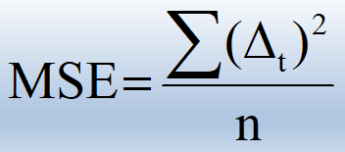
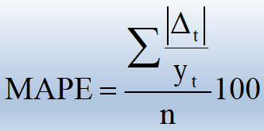
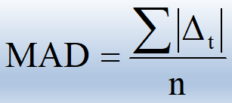
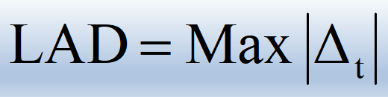
Statistical Methods for Data Science
Time Series
Performance Measures
Mean Square Error (MSE)
Mean Absolute Percent
Error (MAPE)
Mean Absolute Deviation
(MAD)
Largest Absolute Deviation
(LAD)

Slide 74
Statistical Methods for Data Science
Time Series
Exponential Smoothing Techniques
Calculate the exponentially smoothed series F_{t+1} from
the original time series Y_{t} as follows:
F₂ = Y₁
F₃ = αY₂ + (1 – α)F₂
F₄ = α Y₃ + (1 – α)F₃
F_{t+1} = α Y_{t} + (1 – α)F_{t}

Slide 75
Statistical Methods for Data Science
Time Series
Exponential Smoothing Techniques
1. Select an exponential smoothing constant, α, between 0 and 1. Remember that small values of α give less weight to the current value of the series and yield a smoother series. Larger choices of α assign more weight to the current value of the series and yield a more variable series.

Slide 76
Quar/Yr | Utilization(%)
Q1/2017 | 82.50
Q2/2017 | 81.30
Q3/2017 | 81.30
Q4/2017 | 79.00
Q1/2018 | 76.60
Q2/2018 | 78.00
Q3/2018 | 78.40
Q4/2018 | 78.00
Q1/2019 | 78.80
Q2/2019 | 78.70
Q3/2019 | 78.40
Q4/2019 | 80.00
Q1/2020 | 80.70
Q2/2020 | 80.70
Q3/2020 | 80.80
Q4/2020
F_{t} (α=0.2)
82.5
82.5
82.26
82.068
81.4544
80.48352
79.98682
79.66945
79.33556
79.22845
79.12276
78.97821
79.18257
79.48605
79.72884
79.94307
F_{t} (α=0.4)
82.5
82.5
82.02
81.732
80.6392
79.02352
78.61411
78.52847
78.31708
78.51025
78.58615
78.51169
79.10701
79.74421
80.12652
80.39591
F_{t} (α=0.7)
82.5
82.5
81.66
81.408
79.7224
77.53672
77.86102
78.2383
78.07149
78.58145
78.66443
78.47933
79.5438
80.35314
80.59594
80.73878
F_{t+1} = α Y_{t} + (1 – α)F_{t}

Slide 77
Quar/Yr | Utilization (%)
Q1/2017 | 82.50
Q2/2017 | 81.30
Q3/2017 | 81.30
Q4/2017 | 79.00
Q1/2018 | 76.60
Q2/2018 | 78.00
Q3/2018 | 78.40
Q4/2018 | 78.00
Q1/2019 | 78.80
Q2/2019 | 78.70
Q3/2019 | 78.40
Q4/2019 | 80.00
Q1/2020 | 80.70
Q2/2020 | 80.70
Q3/2020 | 80.80
Q4/2020
 | MSE
F_{t} (α=0.2)
82.5
82.5
82.26
82.068
81.4544
80.48352
79.98682
79.66945
79.33556
79.22845
79.12276
78.97821
79.18257
79.48605
79.72884
79.94307
∆_{t}²(α=0.2)
1.44000
0.92160
9.41262
23.56520
6.16787
2.51799
2.78707
0.28683
0.27926
0.52238
1.04406
2.30261
1.47367
1.14738
3.84775
Δ _{t} = Y_{t} - F_{t}

Slide 78
Quar/Yr | Utilization (%)
Q1/2017 | 82.50
Q2/2017 | 81.30
Q3/2017 | 81.30
Q4/2017 | 79.00
Q1/2018 | 76.60
Q2/2018 | 78.00
Q3/2018 | 78.40
Q4/2018 | 78.00
Q1/2019 | 78.80
Q2/2019 | 78.70
Q3/2019 | 78.40
Q4/2019 | 80.00
Q1/2020 | 80.70
Q2/2020 | 80.70
Q3/2020 | 80.80
Q4/2020
 | MSE
F_{t} (α=0.4)
82.5
82.5
82.02
81.732
80.6392
79.02352
78.61411
78.52847
78.31708
78.51025
78.58615
78.51169
79.10701
79.74421
80.12652
80.39591
∆_{t}²(α=0.4)
1.44000
0.51840
7.46382
16.31514
1.04759
0.04584
0.27928
0.23321
0.03601
0.03465
2.21507
2.53761
0.91354
0.45357
2.39527
Δ _{t} = Y_{t} - F_{t}

Slide 79
Quar/Yr | Utilization (%)
Q1/2017 | 82.50
Q2/2017 | 81.30
Q3/2017 | 81.30
Q4/2017 | 79.00
Q1/2018 | 76.60
Q2/2018 | 78.00
Q3/2018 | 78.40
Q4/2018 | 78.00
Q1/2019 | 78.80
Q2/2019 | 78.70
Q3/2019 | 78.40
Q4/2019 | 80.00
Q1/2020 | 80.70
Q2/2020 | 80.70
Q3/2020 | 80.80
Q4/2020
 | MSE
F_{t} (α=0.7)
82.5
82.5
81.66
81.408
79.7224
77.53672
77.86102
78.2383
78.07149
78.58145
78.66443
78.47933
79.5438
80.35314
80.59594
80.73878
∆_{t}²(α=0.7)
1.44000
0.12960
5.79846
9.74938
0.21463
0.29050
0.05679
0.53072
0.01405
0.06993
2.31244
1.33680
0.12031
0.04164
1.57895
Δ _{t} = Y_{t} - F_{t}

Slide 80
F_{t+1} = α Y_{t} + (1 – α)F_{t}
Quar/Yr | Utilization(%)
Q1/2017 | 82.50
Q2/2017 | 81.30
Q3/2017 | 81.30
Q4/2017 | 79.00
Q1/2018 | 76.60
Q2/2018 | 78.00
Q3/2018 | 78.40
Q4/2018 | 78.00
Q1/2019 | 78.80
Q2/2019 | 78.70
Q3/2019 | 78.40
Q4/2019 | 80.00
Q1/2020 | 80.70
Q2/2020 | 80.70
Q3/2020 | 80.80
Q4/2020
MSE
F_{t} (α=0.2)
82.5
82.5
82.26
82.068
81.4544
80.48352
79.98682
79.66945
79.33556
79.22845
79.12276
78.97821
79.18257
79.48605
79.72884
79.94307
3.84775
F_{t} (α=0.4)
82.5
82.5
82.02
81.732
80.6392
79.02352
78.61411
78.52847
78.31708
78.51025
78.58615
78.51169
79.10701
79.74421
80.12652
80.39591
2.39527
F_{t} (α=0.7)
82.5
82.5
81.66
81.408
79.7224
77.53672
77.86102
78.2383
78.07149
78.58145
78.66443
78.47933
79.5438
80.35314
80.59594
80.73878
1.57895
For α=0.7, it is better as the MSE is 1.57895
The exponential smoothing does not have a significant initial delay like the Moving Average where the initial k values are not smoothed

Slide 81
Statistical Methods for Data Science
Time Series
Which performance should be used?
Choice of the modeler
Advantages
MSE gives greater weight to larger deviations (which could result from outliers)
MAD gives less weight to larger deviations
MAPE gives less overall weight to a large deviation if the time series value is large
LAD tells us if all deviations fall below some threshold value
Although we illustrate all 4 techniques, in general focus will be on MSE and MAD.

Slide 82
Statistical Methods for Data Science
Time Series
Smoothing Techniques – Exponential
Objective is to estimate the overall time series as a combination of long term trend and seasonality
Additive Model: X_{t} = F_{t} + S_{t} + ɛ_{t}
Multiplicative Model: X_{t} = F_{t} x S_{t} x ɛ_{t}
Multiplicative model can be converted to additive model by taking log. Other models are also possible
The trend and seasonality can be decomposed using smoothing and regression methods
Exponential smoothing is suitable with constant variance and no seasonality. Recommended for short-term forecast.
Another method for stationarizing the time series is by doing transformation .eg. Differencing

Slide 83
Statistical Methods for Data Science
Time Series
Smoothing Techniques – Moving Averages
Find 2, 3 and 4 quarter moving averages.
Find all fours performance measure and comment on the results obtained
Quarter/Year | Utilization (%)
1/2003 | 82.50
2/2003 | 81.30
3/2003 | 81.30
4/2003 | 79.00
1/2004 | 76.60
2/2004 | 78.00
3/2004 | 78.40
4/2004 | 78.00
1/2005 | 78.80
2/2005 | 78.70
3/2005 | 78.40
4/2005 | 80.00
1/2006 | 80.70
2/2006 | 80.70
3/2006 | 80.80

Slide 84
Statistical Methods for Data Science
Time Series
Smoothing Techniques – Moving Averages
The following data represent 15 quarters of manufacturing capacity utilization
Quarter/Year | Utilization (%)
1/2003 | 82.50
2/2003 | 81.30
3/2003 | 81.30
4/2003 | 79.00
1/2004 | 76.60
2/2004 | 78.00
3/2004 | 78.40
4/2004 | 78.00
1/2005 | 78.80
2/2005 | 78.70
3/2005 | 78.40
4/2005 | 80.00
1/2006 | 80.70
2/2006 | 80.70
3/2006 | 80.80
1. Find 2, 3 & 4 quarter moving average
2. Draw the graph of given data and moving average data
using Excel

Slide 85
Statistical Methods for Data Science
Time Series
Smoothing Techniques – Moving Averages
The following data represent 18 years of International Tourism Arrival in India
Year | 2001 | 2002 | 2003 | 2004 | 2005 | 2006 | 2007 | 2008 | 2009 | 2010 | 2011 | 2012 | 2013 | 2014 | 2015 | 2016 | 2017 | 2018
India | 2.54 | 2.38 | 2.73 | 3.46 | 3.92 | 4.45 | 5.08 | 5.28 | 5.17 | 5.78 | 6.31 | 6.58 | 6.97 | 13.11 | 13.77 | 15.02 | 16.81 | 17.82
1. Find 2, 3 & 4 quarter moving average
2. Draw the graph of given data and moving average data using MS Excel

Slide 86
Statistical Methods for Data Science
Time Series
Smoothing Techniques – Moving Averages
The following data represent 18 years of International Tourism Arrival in India
Year | 2001 | 2002 | 2003 | 2004 | 2005 | 2006 | 2007 | 2008 | 2009 | 2010 | 2011 | 2012 | 2013 | 2014 | 2015 | 2016 | 2017 | 2018
India | 2.54 | 2.38 | 2.73 | 3.46 | 3.92 | 4.45 | 5.08 | 5.28 | 5.17 | 5.78 | 6.31 | 6.58 | 6.97 | 13.11 | 13.77 | 15.02 | 16.81 | 17.82
1. Find 2, 3 & 4 years moving average
2. Draw the graph of given data and moving average data using MS Excel
3. Find the Performance error

Slide 87
Statistical Methods for Data Science
Time Series
Smoothing Techniques – Moving Averages
The following data represent 18 years of International Tourism Arrival in India
Year | 2001 | 2002 | 2003 | 2004 | 2005 | 2006 | 2007 | 2008 | 2009 | 2010
World | 683.40 | 803.20 | 691.00 | 762.00 | 803.40 | 846.60 | 844.00 | 917.00 | 883.00 | 948.00
Year | 2011 | 2012 | 2013 | 2014 | 2015 | 2016 | 2017 | 2018
World | 994.00 | 1039.00 | 1087.00 | 1137.00 | 1195.00 | 1241.00 | 1333.00 | 1409.00
1. Find 3, 4 and 5 years moving average
2. Draw the graph of given data and moving average data using MS Excel

Slide 88
Statistical Methods for Data Science
Time Series
Smoothing Techniques – Moving Averages
The following data represent 12 years of Census population data of India from 1901 to 2011
Year | 1901 | 1911 | 1921 | 1931 | 1941 | 1951 | 1961 | 1971 | 1981 | 1991 | 2001 | 2011
Size of population | 236 | 258 | 251 | 272 | 319 | 361 | 439 | 548 | 685 | 843 | 1027 | 1211
1. Forecast the population size for the year 2021 using 3 & 4 year moving average
2. Draw the graph of given data and moving average data using MS Excel
3. Compute all four performance measure and comment on your results.

Slide 89
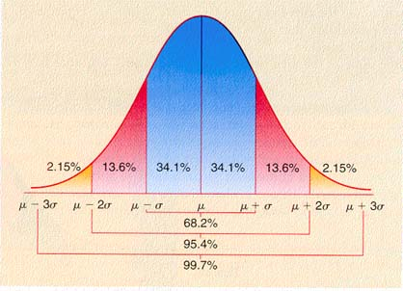
Thank you

